Slide 1
Coursera Capstone Project : Applied Data Science
KSHITIJ BAJPAI
GCET, GREATER NOIDA

Slide 2
Overview
Introduction Business Problem Data
Methodology
Results Conclusion

Slide 3
Introduction
Delhi is busy state and it is rapidly growing day by day. Until corona hits it has an increasing economy and jobs were literally flouring for a certain pay scale people. It is situated in northern area of India i.e. 28.7041° N, 77.1025° E.
Being busy and filled with approximately 2 cr. People in the area of 1484 km² makes it crowded. There are certain malls and location for buying your stuff with quality items while there are also places where all items are cheap and dependable. Being one the most crowded area it suffers from traffic, busy line and crowded location which makes people who are in hurry to suffer a lot.

Slide 4
Business Problem
In a busy location like Delhi it is hard to search a place which is near and has good rating while it should also be free to take in customers. This project will help those people who want have food and don’t wish to wait for long.

Slide 5
Data
Places
The data of the neighbourhoods in Delhi can be extracted out by web scraping using BeautifulSoup library for Python. The neighbourhood data is scraped from a Wikipedia webpage.
Coordinates
The location data is scraped using the webpage google .Beautiful soup and regex python libraries are used

Slide 6
Data
Venues
From the location data obtained after Web Scraping and google scraping, the venue data is found out by passing in the required parameters to the FourSquare API, and creating another DataFrame to contain all the venue details along with the respective neighbourhoods.

Slide 7
Methodology
We differentiated the all category from the original category
and find the nearest places by taking example coordinate.
And plotted the venues.

Slide 8
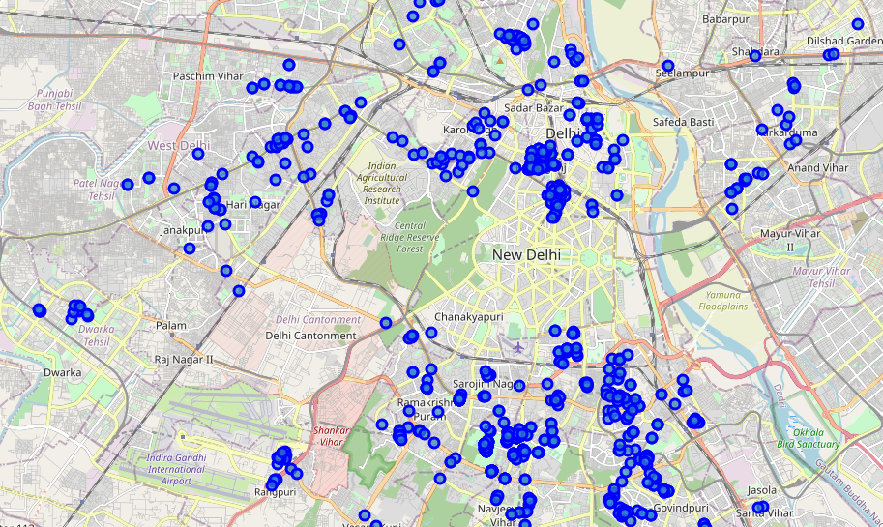
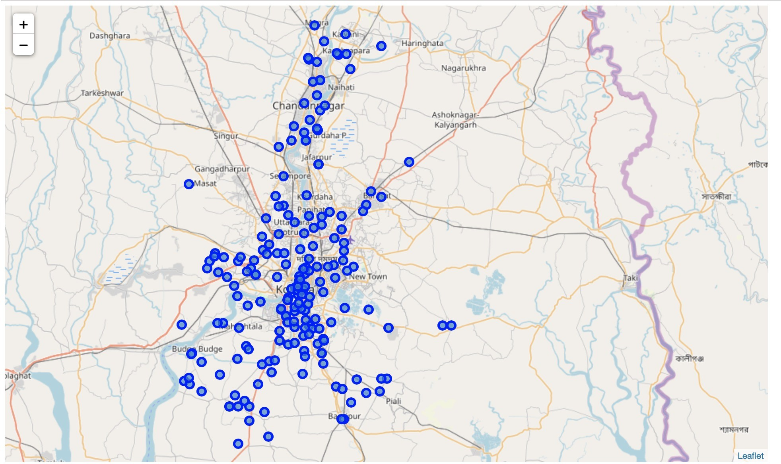
Methodology
Figure: Food venues in Delhi.

Slide 9
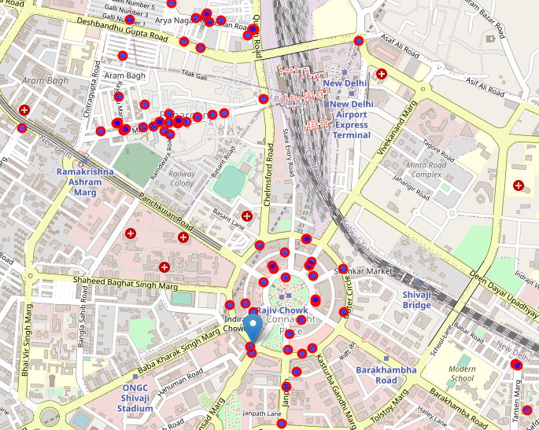
Results
We found all the places and mapped them into frame in increasing order of their distance from example coordinate.
Figure: Food places near example coordinate.

Slide 10
Conclusion
If a person found himself or herself waiting more than usual they can move onto next venues nearest and save time.

